Slide 1
LIPID MAPS Lipidomics Gateway Workshop
Eoin Fahy
University of California San Diego
Leipzig, Sept. 26th 2018
Funded by Wellcome Trust

Slide 2
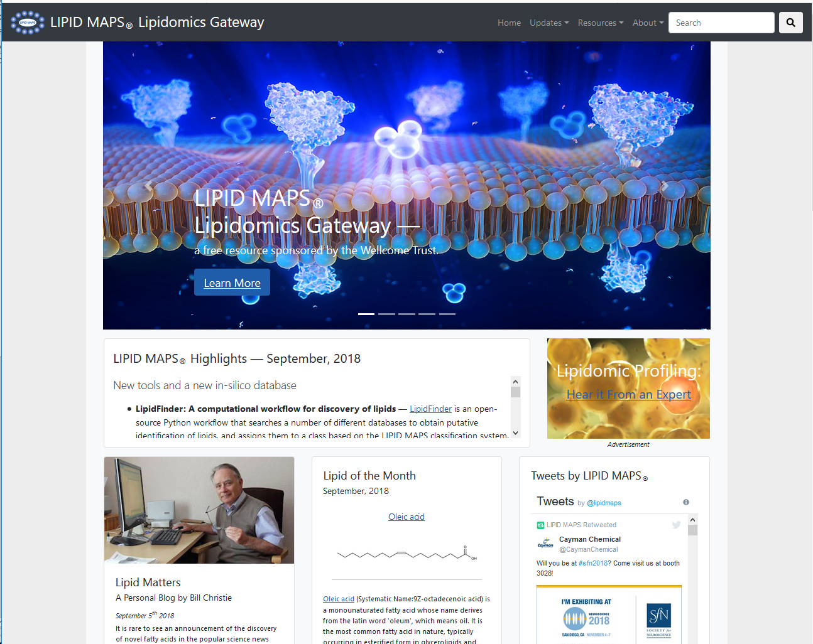
LIPID MAPS Lipidomics Gateway
^{https://www.lipidmaps.org}
Now hosted in the U.K. (Babraham Institute)
Formerly located at the University of California San Diego from 2003-2018

Slide 3
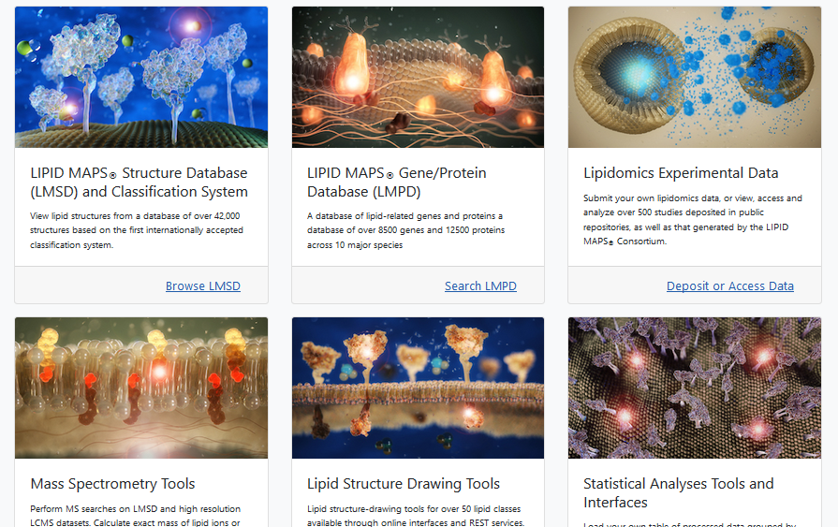
LIPID MAPS Lipidomics Gateway

Slide 4
Definition of a lipid*
Lipids may be broadly defined as hydrophobic or amphiphilic small molecules that originate entirely or in part from two distinct types of biochemical subunits or "building blocks": ketoacyl and isoprene groups. Using this approach, lipids may be divided into eight categories : fatty acyls, glycerolipids,
,glycerophospholipids, sphingolipids, saccharolipids and polyketides (derived from condensation of ketoacyl subunits); and sterol lipids and prenol lipids (derived from condensation of isoprene subunits).
* Fahy,E. et al, Journal of Lipid Research, Vol. 46, 839-862, May 2005

Slide 5
Fundamental biosynthetic units of lipids

Slide 6
LIPID MAPS Classification System Categories and Examples
Category | Abbreviation | Example
Fatty acyls | FA | Dodecanoic acid
Glycerolipids | GL | 1-hexadecanoyl-2-(9Z-octadecenoyl)-sn-glycerol
Glycerophospholipids | GP | 1-hexadecanoyl-2-(9Z-octadecenoyl)-sn-glycero-3-phosphocholine
Sphingolipids | SP | N-(tetradecanoyl)-sphing-4-enine
Sterol lipids | ST | Cholest-5-en-3β-ol
Prenol lipids | PR | 2E,6E-farnesol
Saccharolipids | SL | UDP-3-O-(3R-hydroxy-tetradecanoyl)-αD-N-acetylglucosamine
Polyketides | PK | Aflatoxin B₁

Slide 7
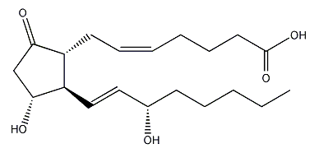
LIPID MAPS Lipid classification system
Category
Abbrev
Example
Fatty Acyls
Glycerolipids
Glycerophospholipids
Sphingolipids
Sterol Lipids
Prenol Lipids
Saccharolipids
Polyketides
FA
GL
GP
SP
ST
PR
SL
PK
Arachidonic acid
1-hexadecanoyl-sn-glycerol
1-hexadecanoyl-2-(9Z-octadecenoyl)-
sn-glycero-3-phosphocholine
Sphingosine
Cholesterol
Retinol
Kdo₂-lipid A
epothilone D
Name: PGE₂
LM_ID: LMFA03010003
LM_ID description:
Database: LM (LIPID MAPS)
Category: FA (Fatty Acyls)
Main Class: 03 (Eicosanoids)
Sub Class: 01 (Prostaglandins)
Unique identifier within a sub class: 0003

Slide 8
LMSD: LIPID MAPS Structure Database
Over 43,000 classified structures as of 9/20/2018
Full structures in multiple formats, exact mass and inline m/z features
Relevant database cross references, InChIKey values for each structure
Calculated physicochemical properties added for each structure
Links to internal/external MS data
Ongoing screening of major lipid-related journals

Slide 9
Composition and curation of the LMSD
Structures from core labs and partners
New structures identified by LIPID MAPS experiments
LIPID MAPS structure database
(LMSD)
Computationally generated structures
Public databases
Curation
Websites,
Publications
Curation

Slide 11
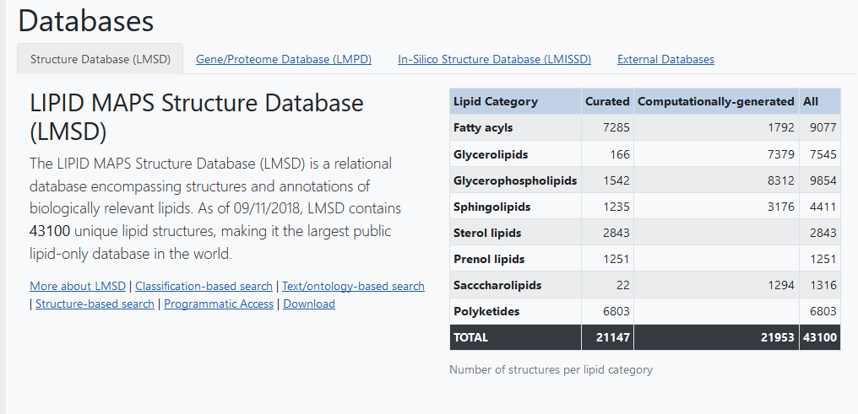
LMSD: LIPID MAPS Structure Database
Resources →Databases

Slide 12
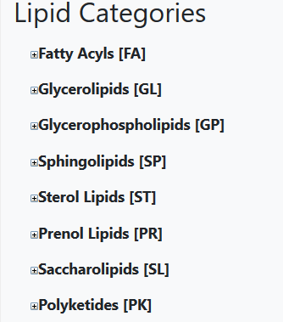
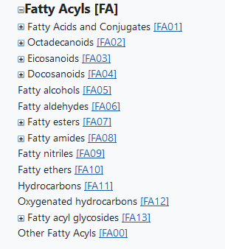
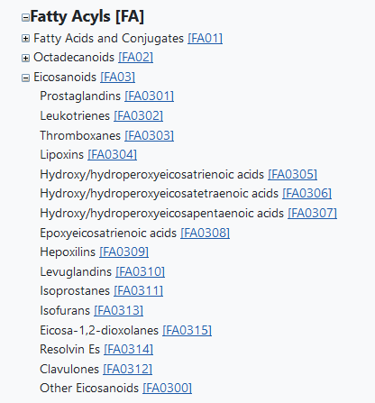
Search LMSD by browsing classification hierarchy
Resources →Classification

Slide 13
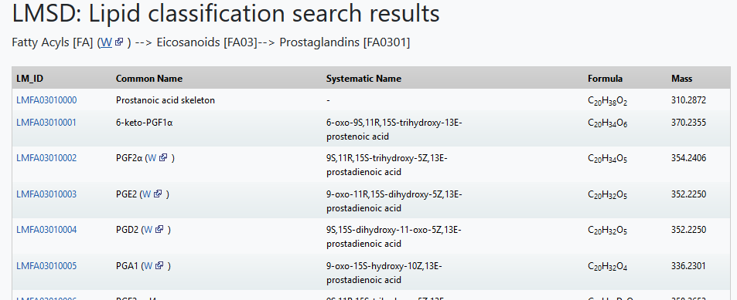
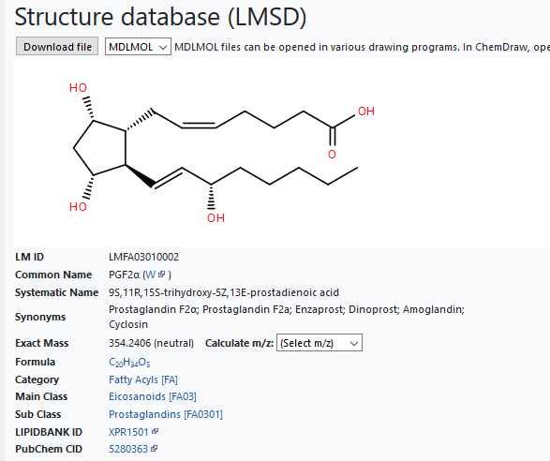
Search LMSD by browsing classification hierarchy
Resources →Classification

Slide 14
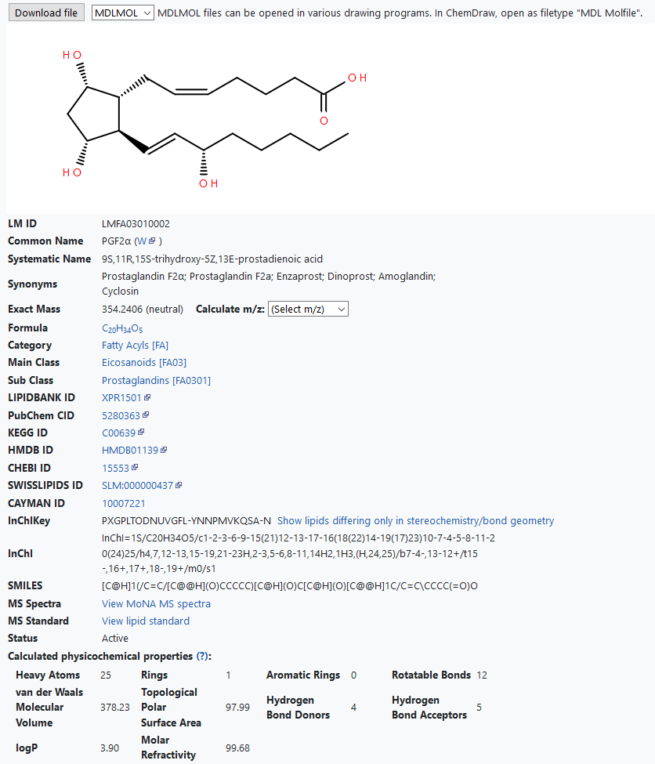
LMSD Detail view for a lipid structure
Download structure
Structure
LM_ID
Names, synonyms
m/z calculation tool
Lipid classification
Database cross-references
InChiKey identifier
SMILES
MS/MS spectra
Physicochemical properties

Slide 15
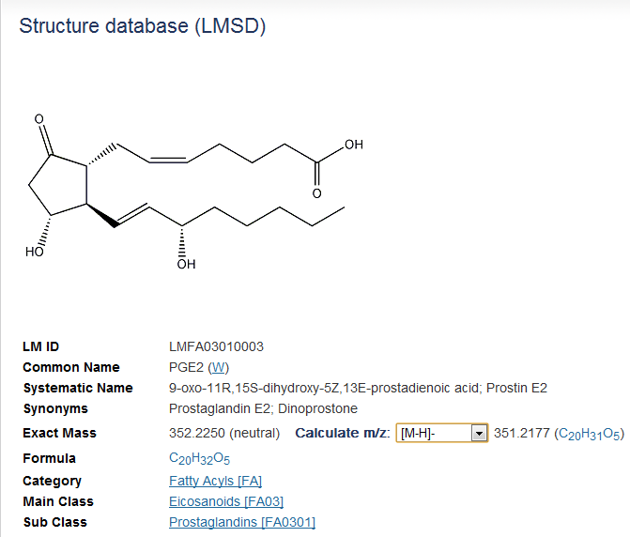
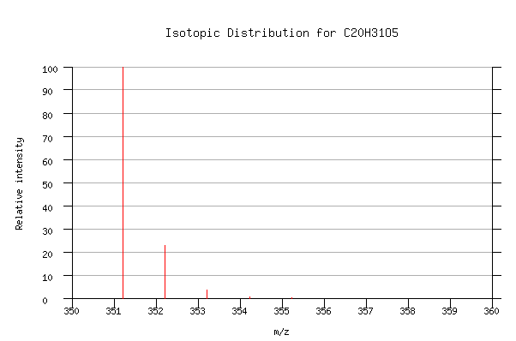
LMSD detail page: m/z calculator
m/z for selected ion type/adduct
Isotopic distribution profile

Slide 16
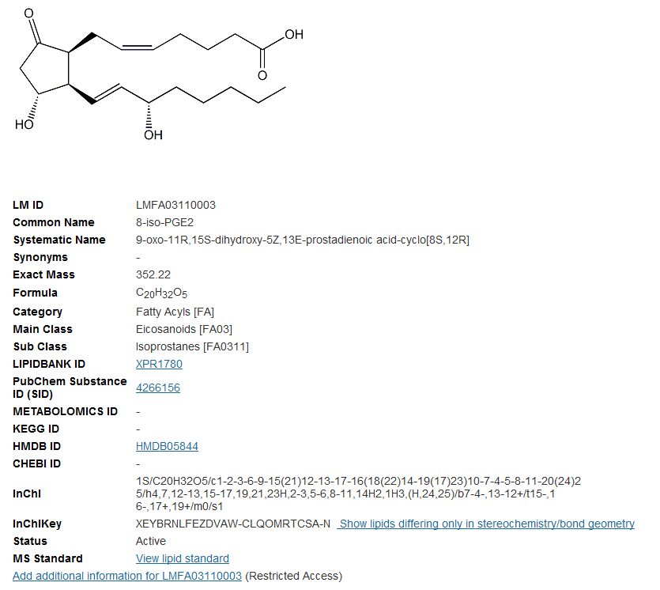
Use InChIKey to find structures differing only in stereochemistry, double-bond geometry or isotopic labeling

Slide 17
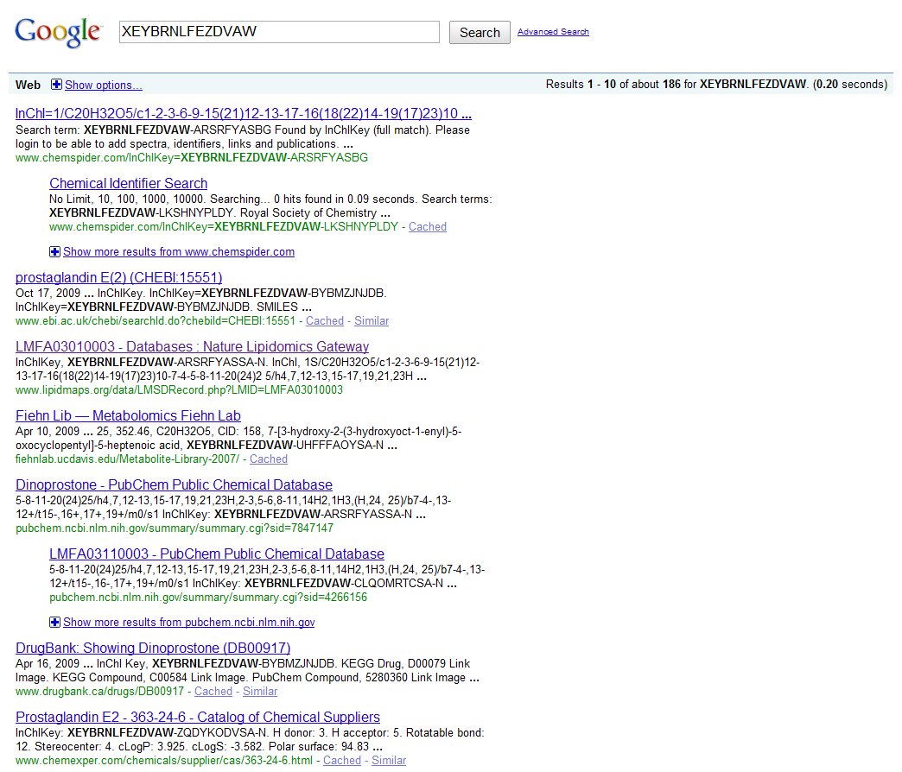
Use InChIKey (full or partial) to perform a Google structure search
European Bioinformatics Inst.
LIPID MAPS
PubChem

Slide 18
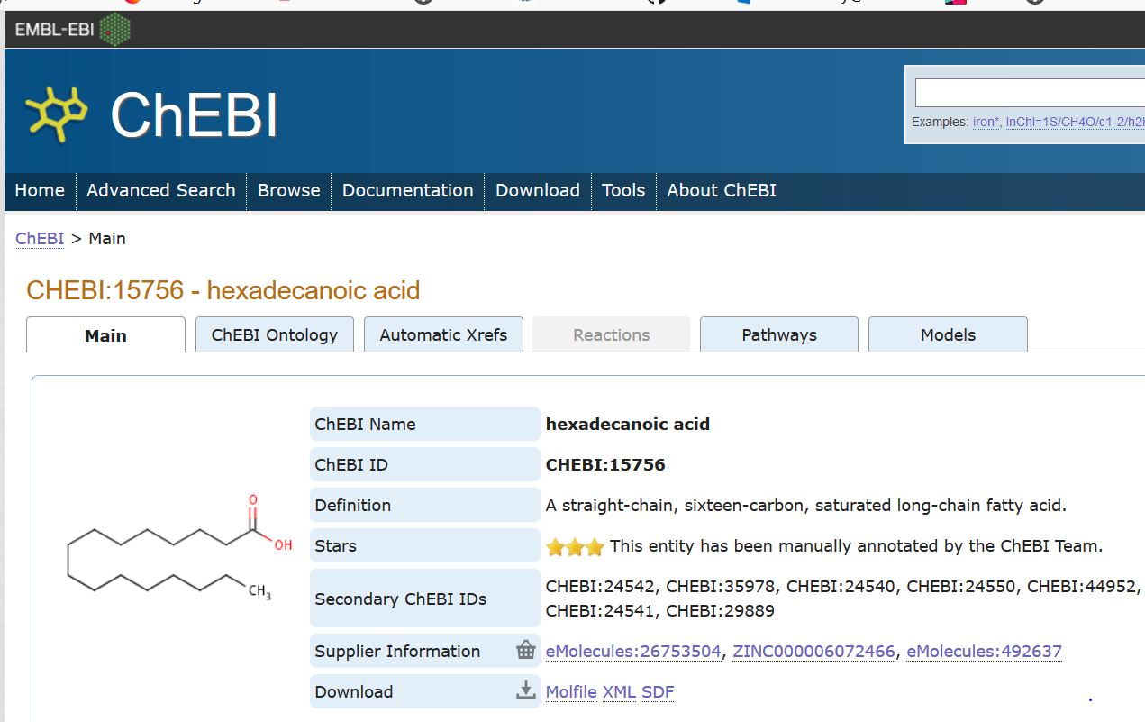
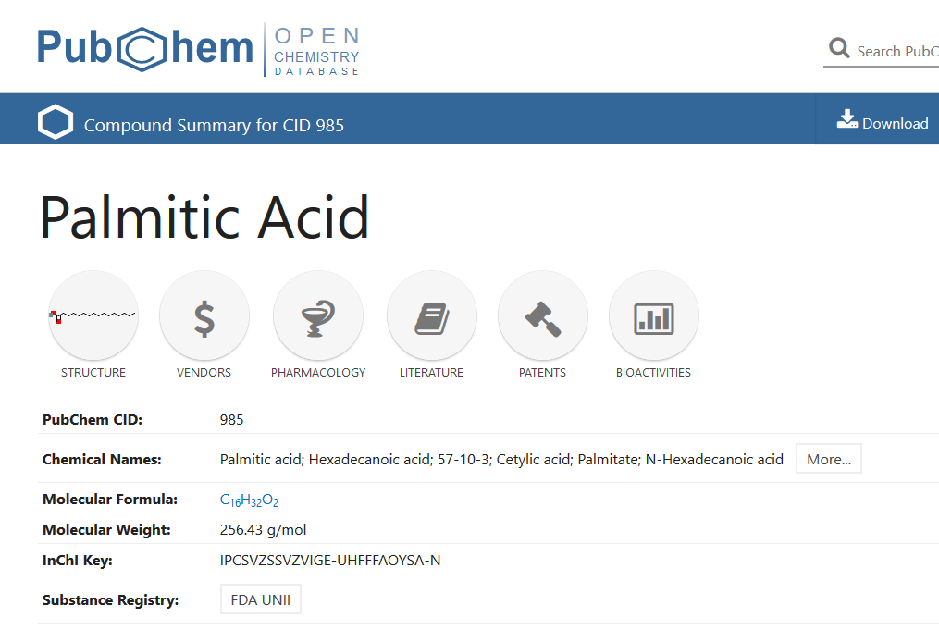
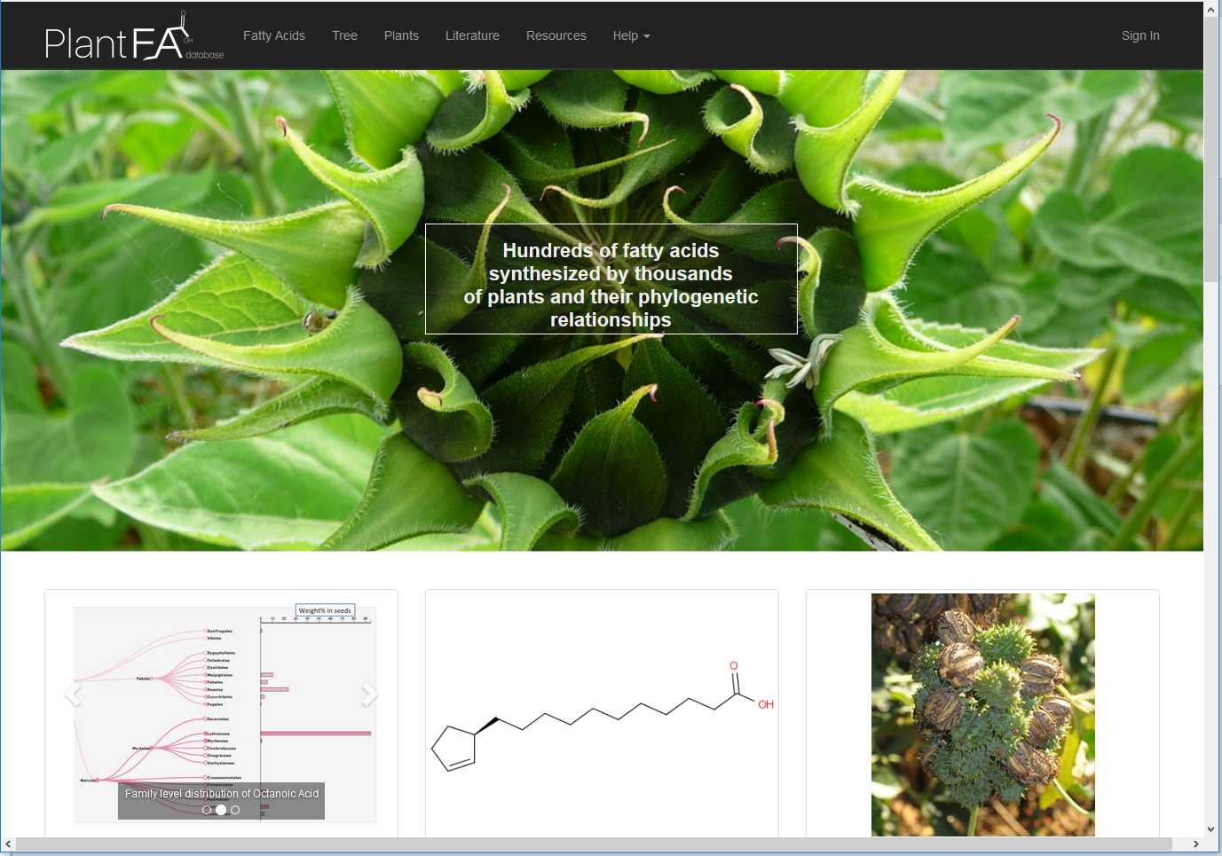
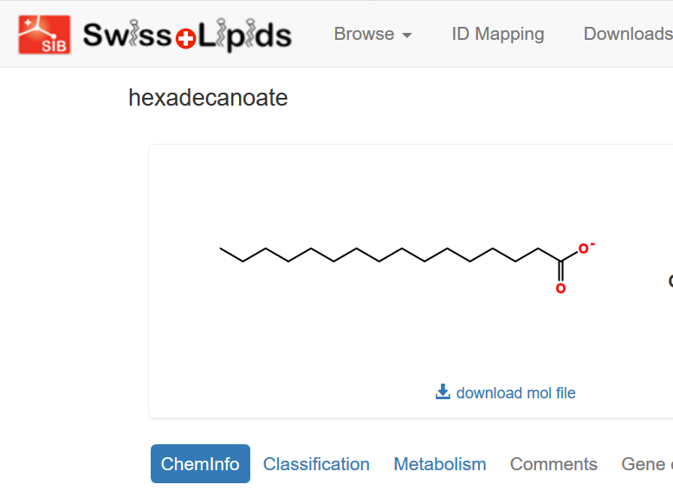
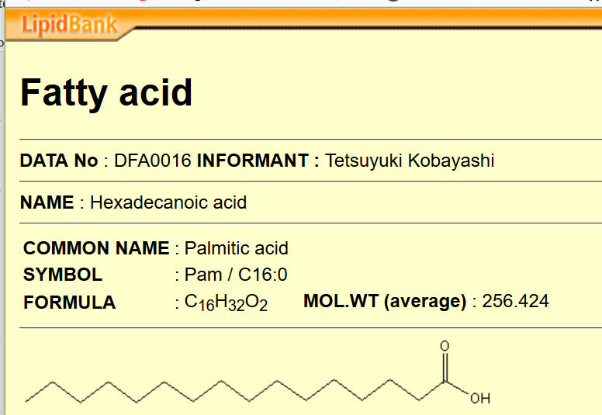
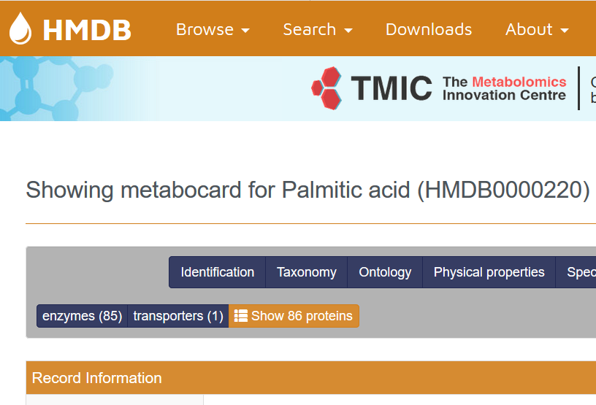
Linking LMSD to other structure databases and resources
ChEBI
PubChem
Plant FattyAcid db
SwissLipids
LipidBank
HMDB

Slide 19
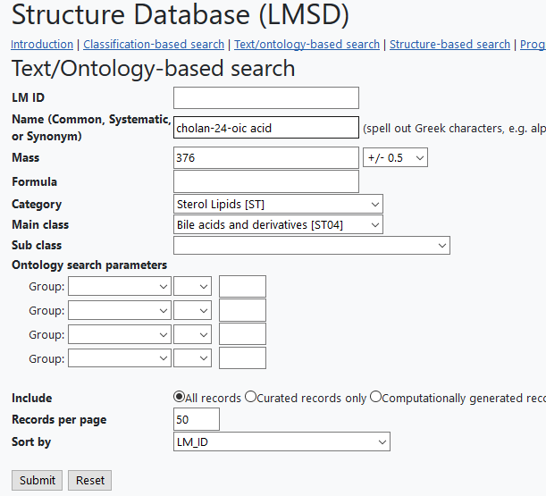
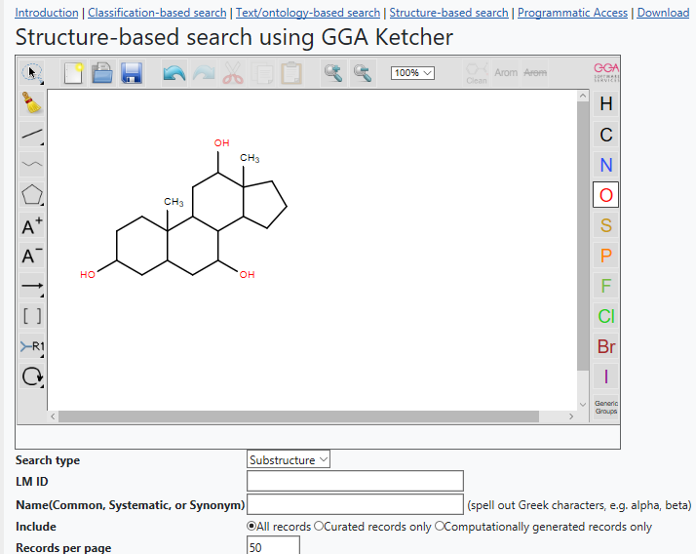
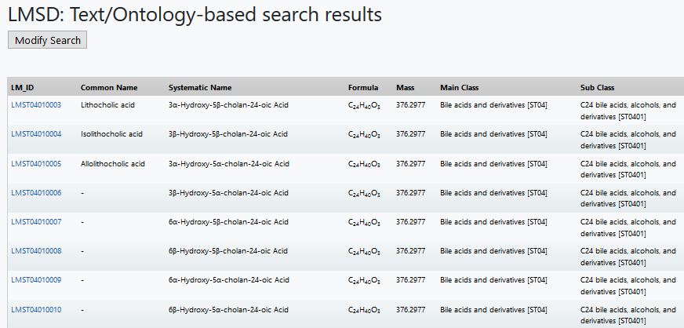
Search LMSD by structure, text, mass, formula ,ontology
Resources →Databases -> Text/ontology or Structure search

Slide 20
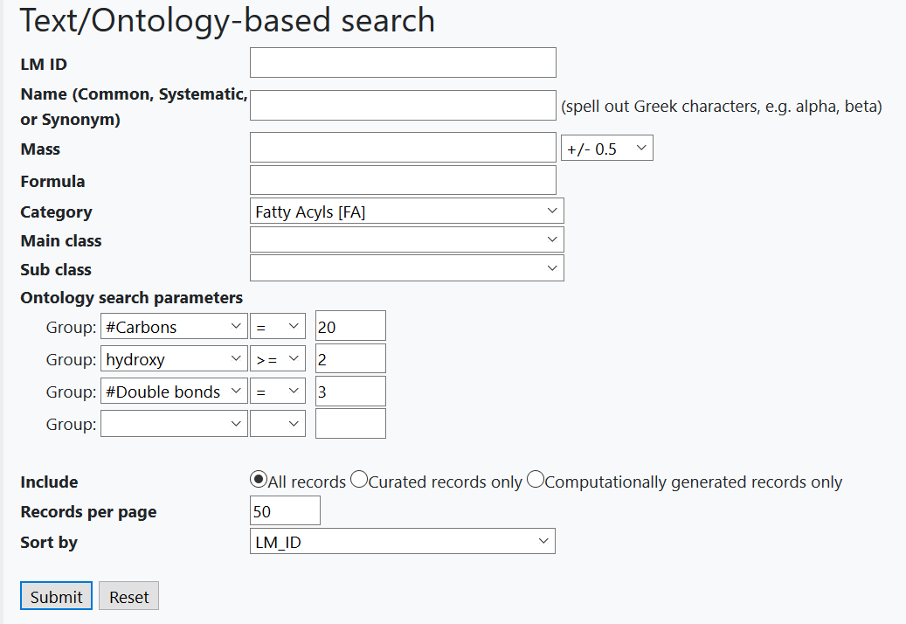
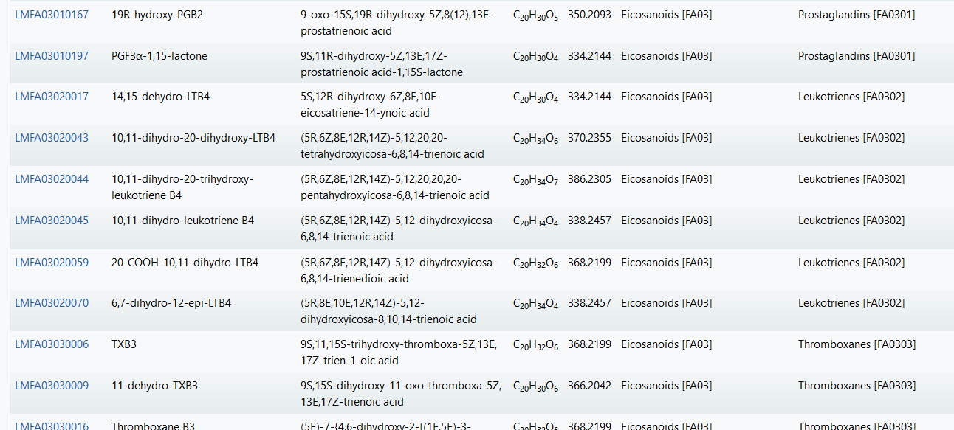
Search LMSD by ontology
Resources →Databases -> Text/ontology

Slide 21
Querying Lipidomics Gateway website as well as LIPID MAPS databases via “Quick search”
Search the Lipidomics Gateway html pages by keyword, or the databases by lipid class, common name, systematic name or synonym, mass, formula, InChIKey, LIPID MAPS ID, gene or protein term.
Multi-purpose
Small “footprint”
High visibility (on home page)

Slide 22
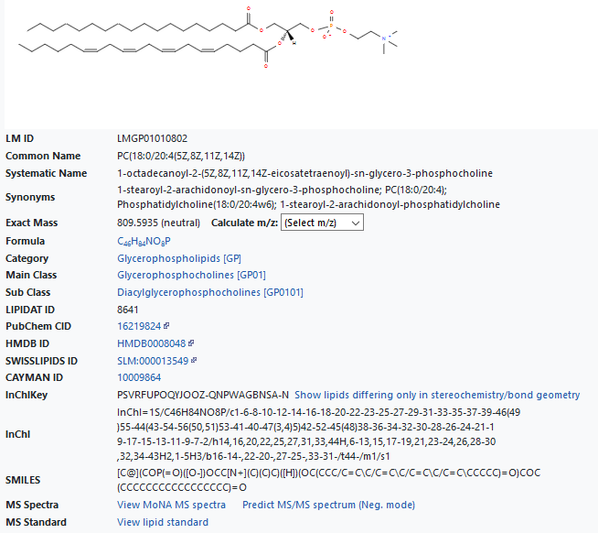
Linking MS spectra to lipid structures in detail view

Slide 23
Linking MS spectra to lipid structures in detail view
Curated and annotated MS/MS spectra of lipid standards contributed by LIPID MAPS core labs
Links to Massbank spectra (via Massbank of North America (MoNA) repository at UC Davis. Contains both experimentally obtained and predicted (LipidBlast) spectra
Predicted MS/MS spectra for selected lipid classes using LIPID MAPS algorithms

Slide 24
Linking MS spectra to lipid structures in detail view
Curated and annotated MS/MS spectra of lipid standards contributed by LIPID MAPS core labs
Links to Massbank spectra (via Massbank of North America (MoNA) repository at UC Davis. Contains both experimentally obtained and predicted (LipidBlast) spectra
Predicted MS/MS spectra for selected lipid classes using LIPID MAPS algorithms (Covers glycerolipids, phospholipids and ceramides)
Source | # of Lipids in LMSD | Total # of Spectra | Comments
Lipid Standards | 443 | 557 | Curated/annotated by LIPID MAPS core labs
Massbank (MoNA) | 7,304 | 21,097 | ~14,000 are predicted ~7,000 are experimental
LM Predicted spectra | 15,179 | 15,179 | MG/DG/TG PA/PC/PE/PG/PS/PI Cer

Slide 25
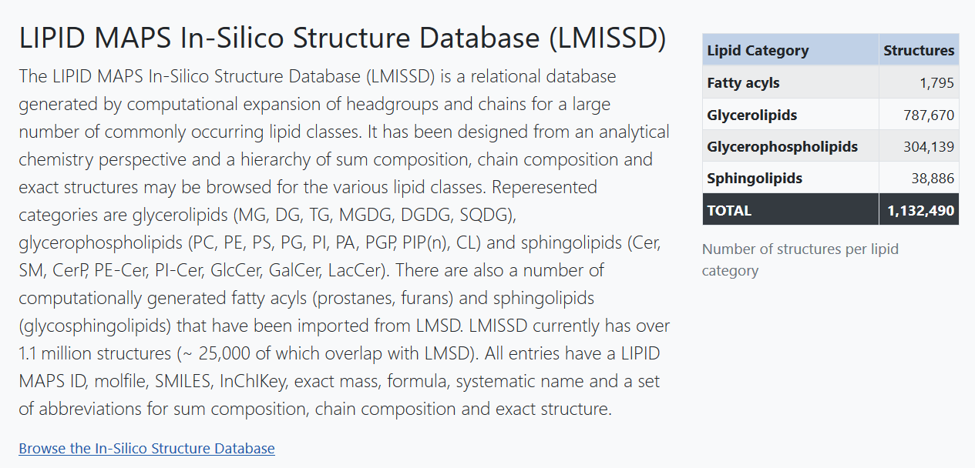
The LIPID MAPS In-Silico Structure Database (LMISSD) is a relational database generated by computational expansion of headgroups and chains for a large number of commonly occurring lipid classes. It contains over 1.1 million structures and is a separate entity from the curated LIPID MAPS Structure Database (LMSD) which is a repository for experimentally identified lipids.
Resources →Databases → LMISSD

Slide 26
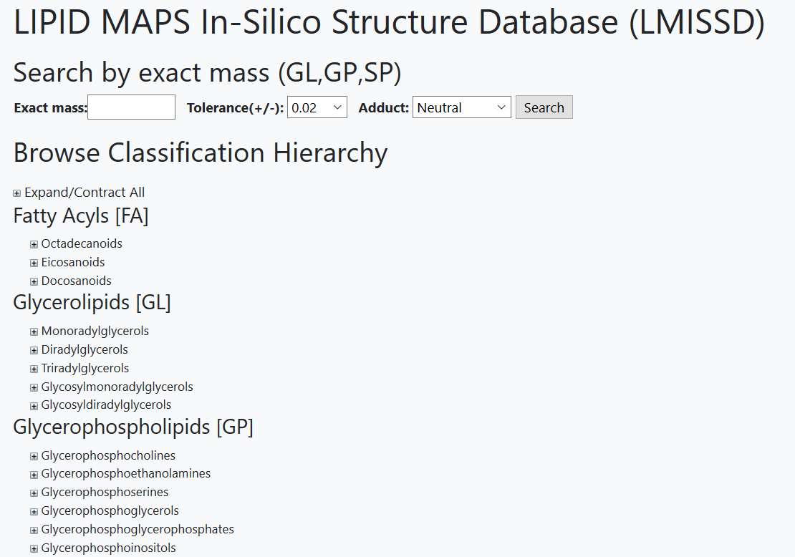
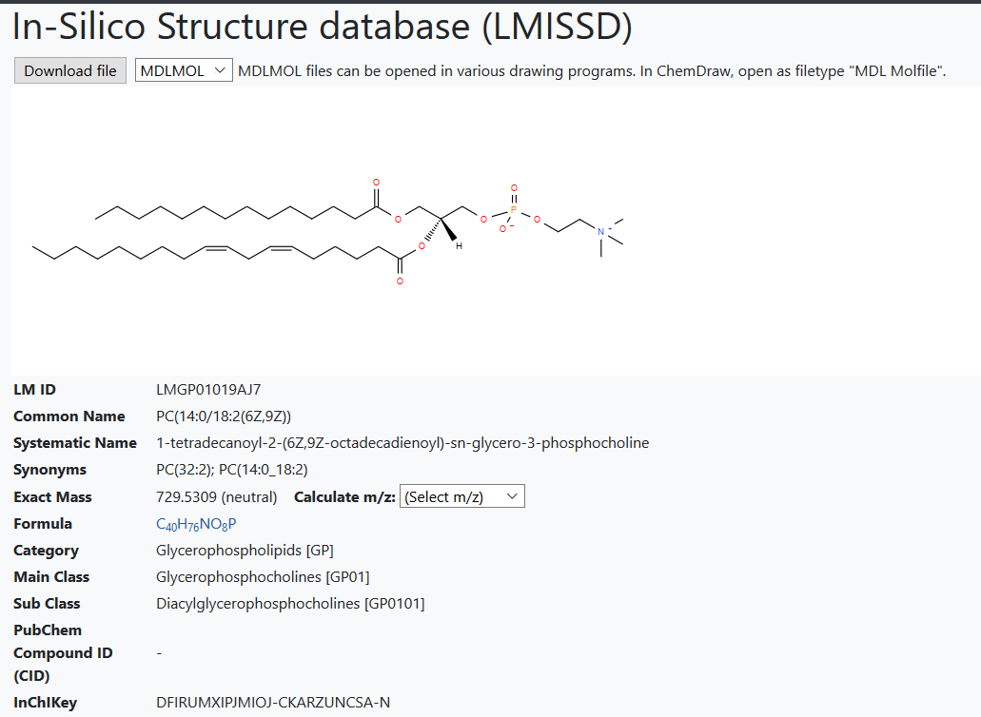
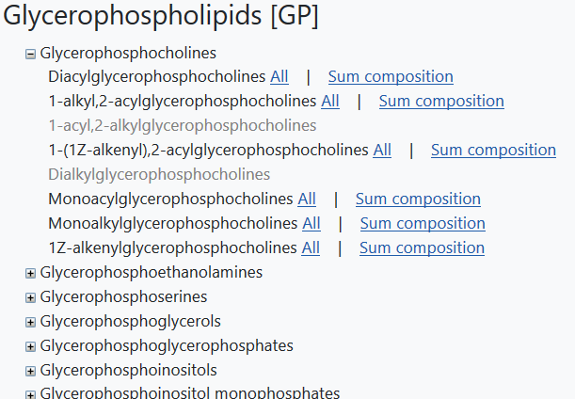
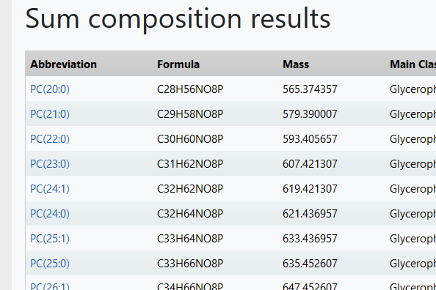
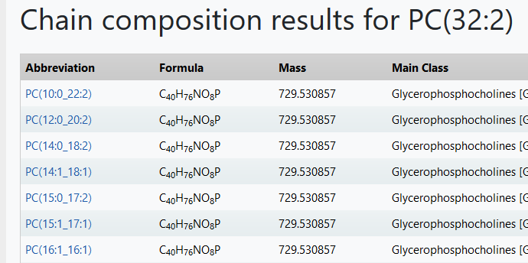
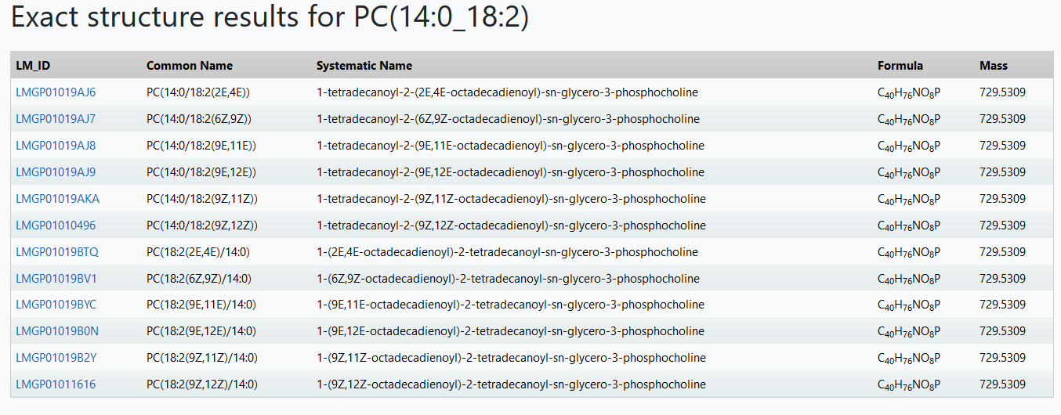
Navigating the hierarchy

Slide 27
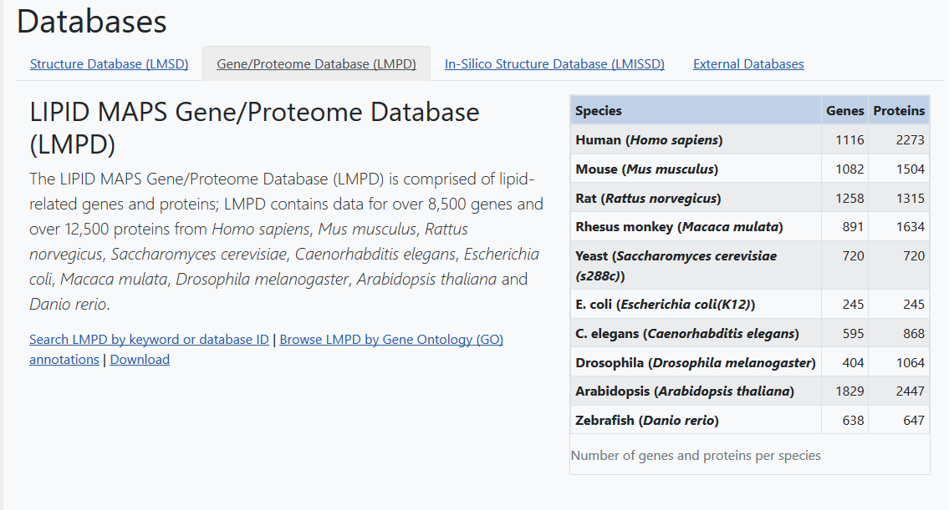
Lipid MAPS Gene/Proteome Database (LMPD)
Resources →Databases → LMPD

Slide 28
LMPD:Data collection strategy
Lipid-related keywords in gene names, metabolic pathways and ontology terms
Manual curation
Entrez Gene ID list
Python
program
NCBI Entrez
UniProt
Gene, mRNA, protein data, PTM variants, motifs, homologs, cross-references, related proteins, ontologies, annotations, etc.
LMPD database

Slide 29
LMPD organization:
Gene-> mRNA-> (apo)protein -> mature protein
Entrez Gene ID (DNA/genomic links)
RefSeq mRNA ID’s (both coding and UTR variants)
RefSeq protein ID’s and sequences (unique isoforms)
Post–translationally modified variants (e.g. apo-, mature forms, leader sequences, etc.)

Slide 30
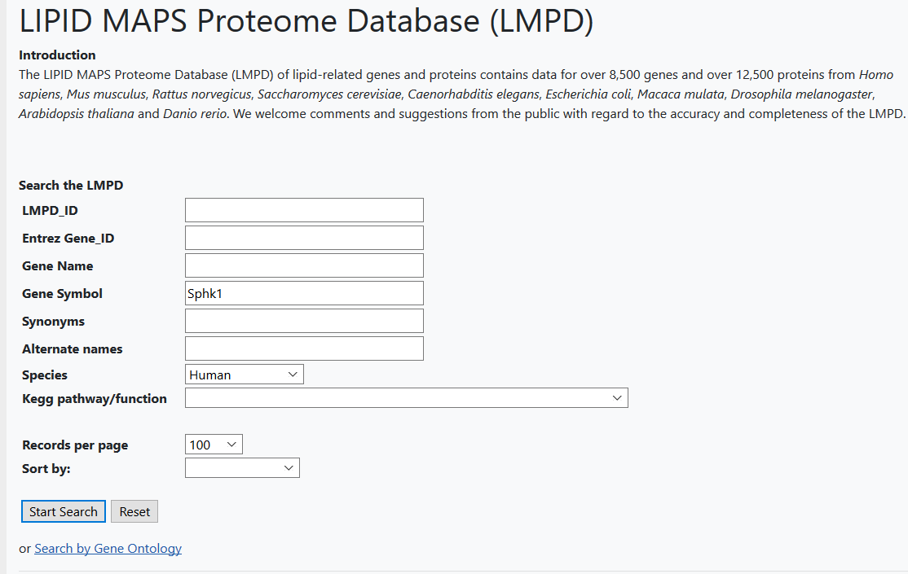
LMPD query page
Resources →Databases → LMPD →Search LMPD

Slide 31
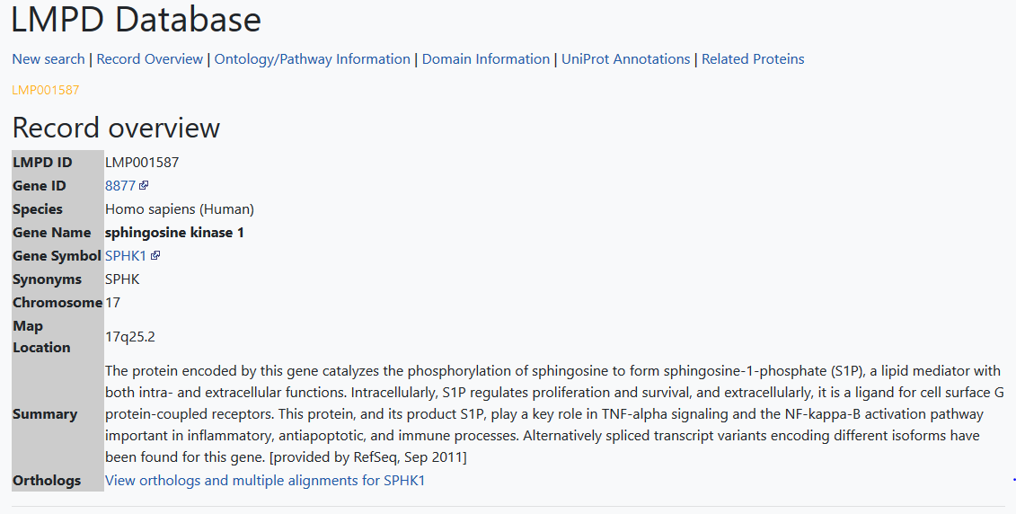
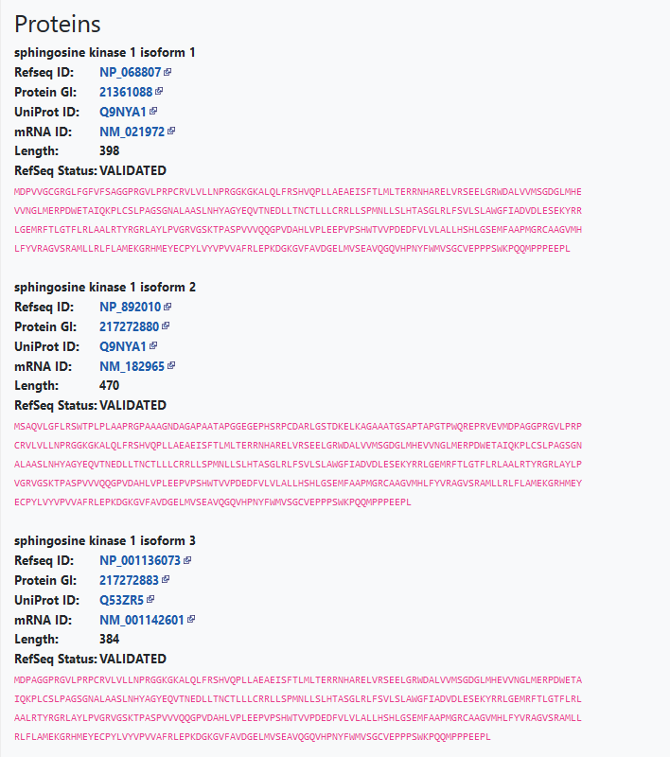
LMPD overview page: listing of annotations and isoforms

Slide 32
LIPID MAPS: Recommendations for drawing structures Consistent structure representation across classes
Fatty Acyls(FA)
Glycerolipids (GL)
Glycerophospholipids (GP)
Sphingolipids (SP)
Sterol Lipids (ST)
Prenol Lipids (PR)

Slide 33
Structural comparison of SM and PC

Slide 34
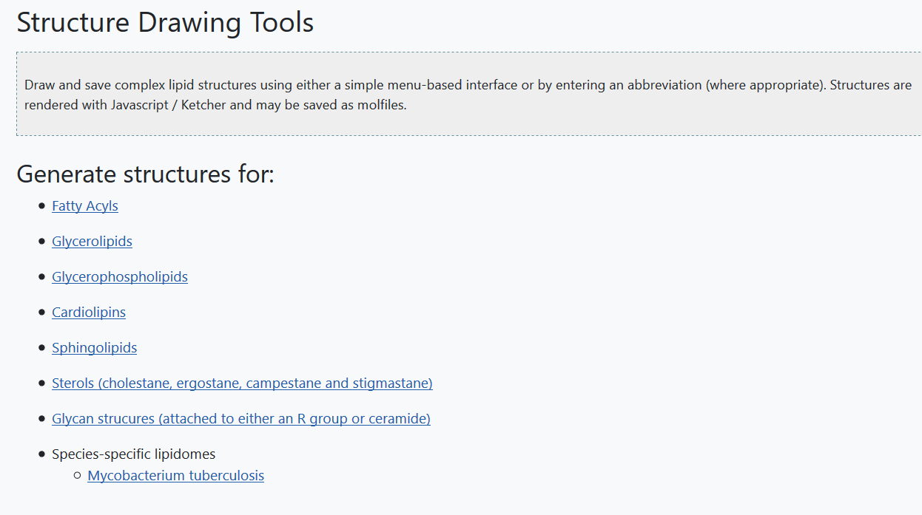
Drawing lipid structures
Resources →Tools→Structure Drawing
Online drawing tools for various lipid categories (FA,GL,GP,SP,ST)

Slide 35
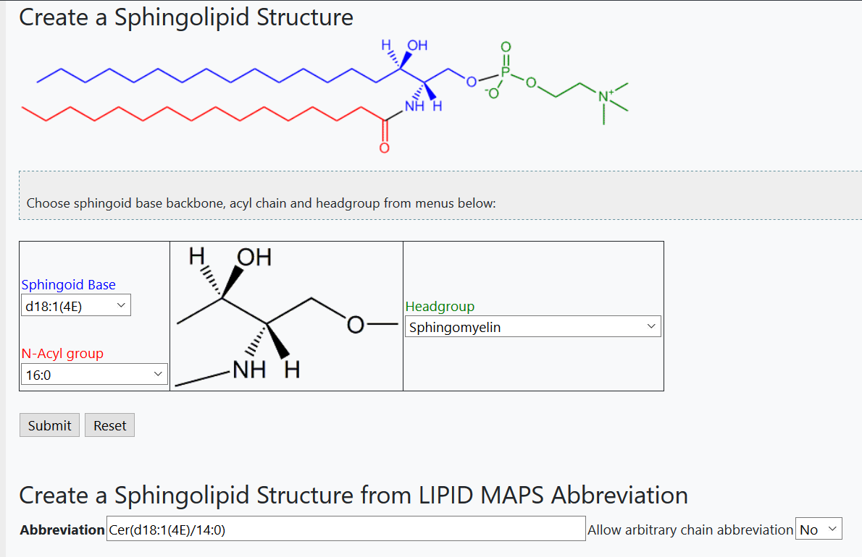
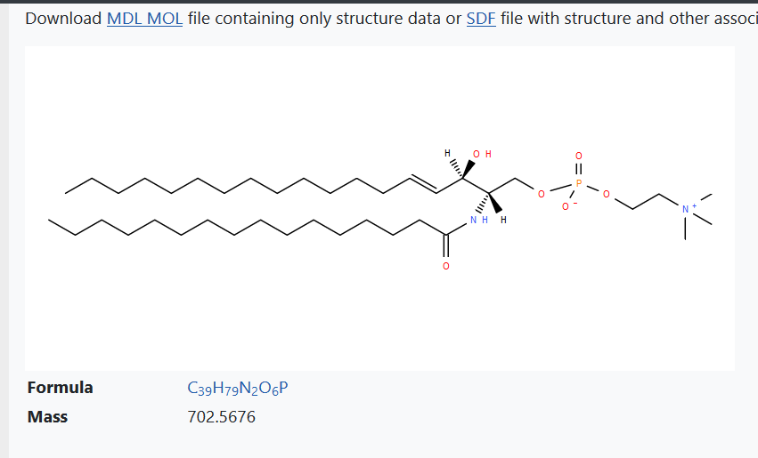
(a) Menu-based drawing interface
(b) Abbreviation-based drawing interface

Slide 36
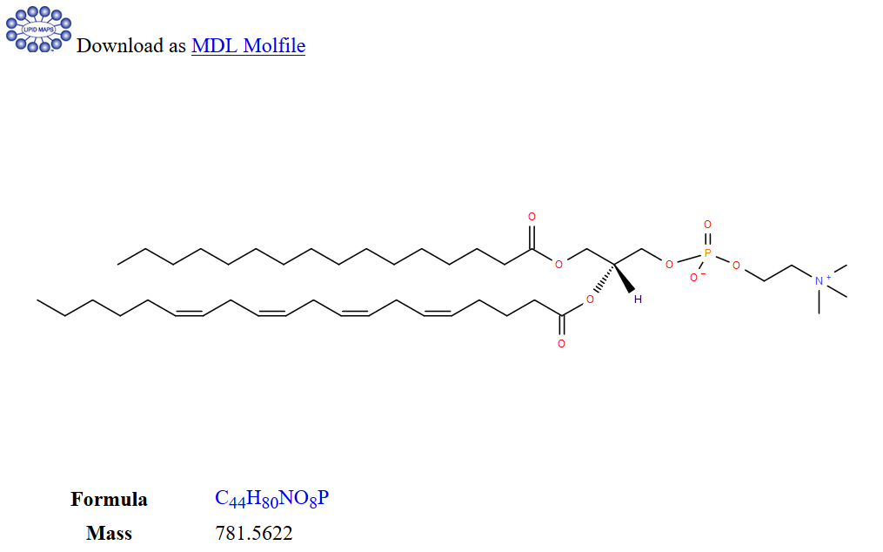
(c) REST service
Resources →REST service
53 different lipid classes with examples and explanation of the abbreviation syntax

Slide 37
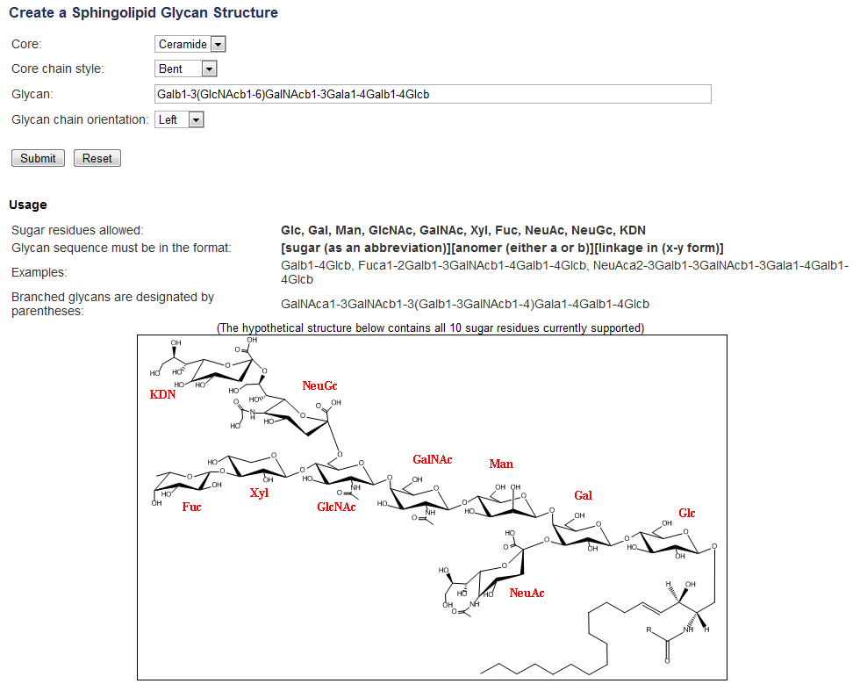
Online generation of glycan structures in full chair conformation
Resources →Tools→Structure Drawing→Glcans
Sugars
Glc
Gal
GlcNAc
GalNac
Xyl
Fuc
Man
NeuAc
NeuGc
KDN
Anomeric Carbon
α or β linkages may be specified

Slide 38
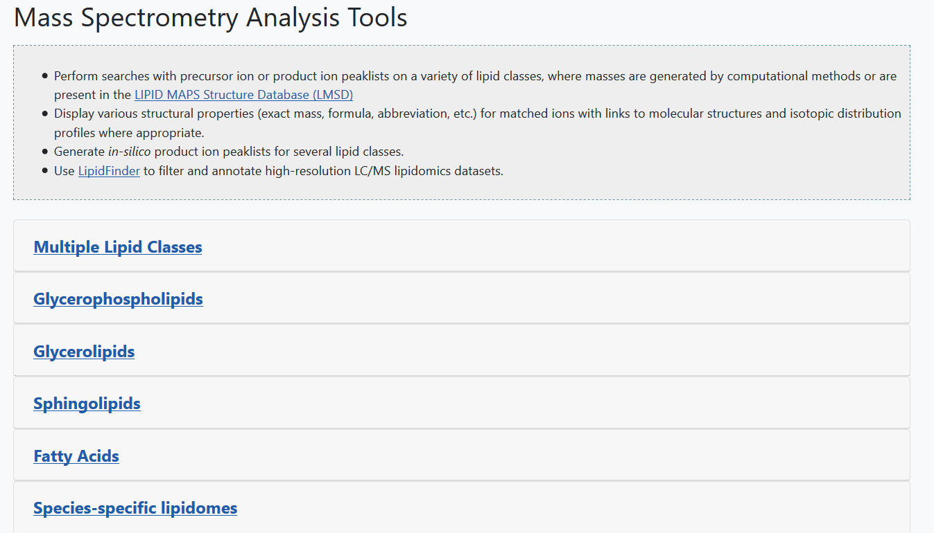
Mass spectrometry tools
Resources →Tools → MS analysis

Slide 39
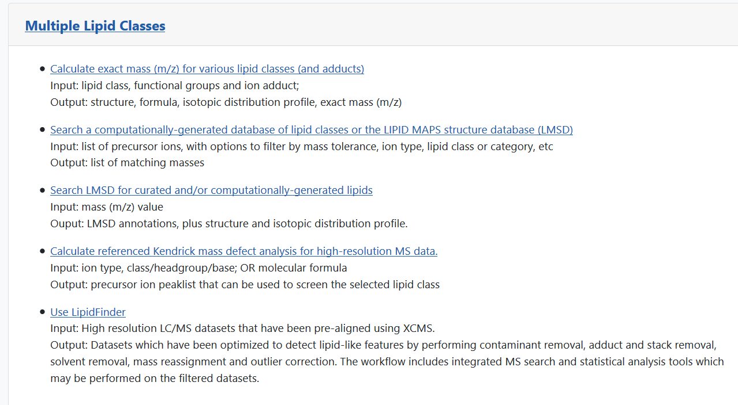
Mass spectrometry tools
Resources →Tools → MS analysis

Slide 40
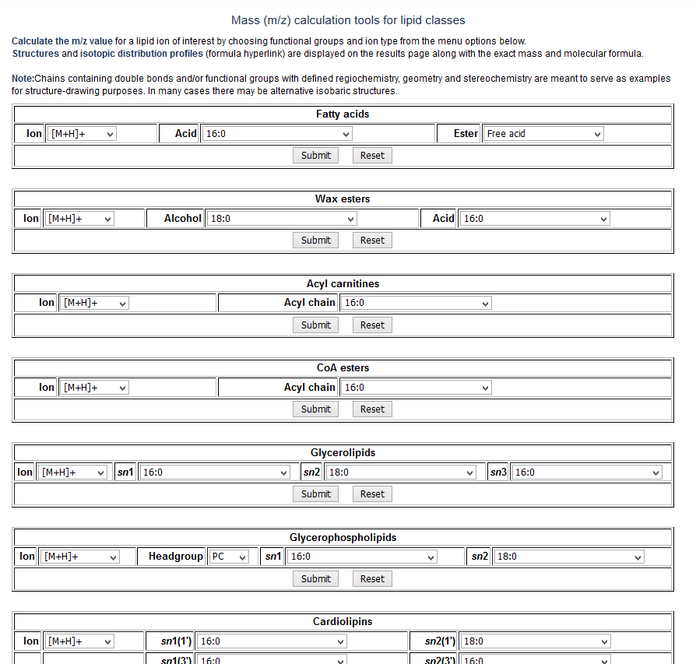
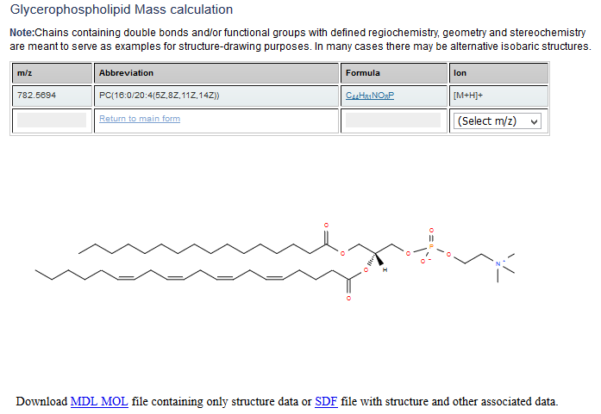
Calculate the exact mass of a lipid
(Display structure (save as molfile) and isotopic distribution profile)
Covers glycerolipids, phospholipids, sphingolipids, fatty acids, wax esters, acylcarnitines, acyl CoA’s, cardiolipins and cholesteryl esters
Resources →Tools → MS analysis→Multiple lipid classes→Calculate exact mass..

Slide 41
Enumeration of “bulk” lipid species from selected lists of acyl/alkyl chains
Suite of combinatorial expansion tools
Database of lipid “bulk” species, exact masses, formulae, annotations
Glycerolipids
Acyl CoA’s
Phospholipids
Acyl carnitines
Cardiolipins
Chol. esters
Sphingolipids
Wax esters
Fatty acids

Slide 42
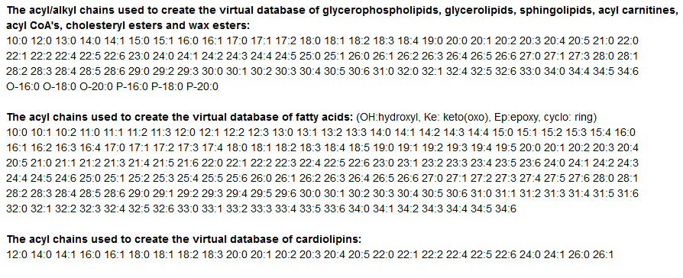
Creation of a virtual lipid database
Choice of range of acyl/alkyl chains
These are used to create “bulk” species e.g. PC(38:4), PE(O-36:0), Cer(d32:1), HexCer(d40:2), TG(54:2), DG(32:0), FA(20:3(OH)), CE(18:1)
Conservative approach: stereochemistry, sn (glycerol) position, double bond/functional group regiochemistry, double bond geometry not defined.
Links to: On-demand expansion of all possible chain combinations (within defined limits)
Links to: Matches of bulk species to discrete structures in LMSD database (examples)

Slide 43
Virtual database of bulk lipids: number of entries per class
Monoradylglycerols | 84 |  | Fatty acids | 13590
Diradylglycerols | 615 |  | Acyl carnitines | 78
Triradylglycerols | 1844 |  | Chol. Esters | 78
Digalactosyl DG's | 553 |  | Acyl CoA's | 78
Monogalactosyl DG's | 553 |  | Wax esters | 403
Sulfoquinovosyl DG's | 553
 |  |  | Ceramides | 258
PA | 1308 |  | Ceramide phosphates | 258
PC | 1308 |  | PE-Ceramides | 230
PE | 1308 |  | PI-Ceramides | 230
PG | 1308 |  | Mannosyl-di-IP-ceramides | 258
PI | 1308 |  | Mannosyl-IP-ceramides | 258
PIP | 1308 |  | Hexosyl ceramides | 258
PS | 1308 |  | Lactosyl ceramides | 258
Cardiolipins | 375 |  | Sphingomyelins | 258
 |  |  | Sulfatides | 258

Slide 44
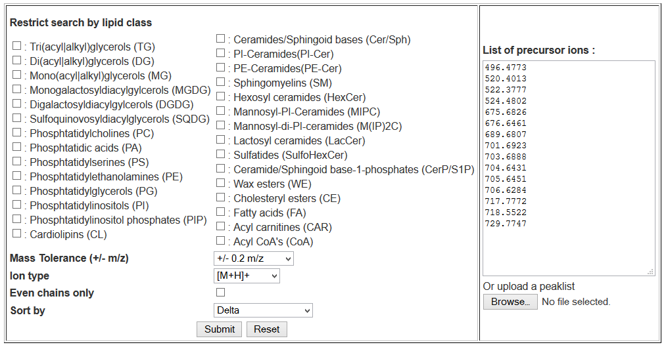
Precursor ion search interface to virtual database
Input: Either copy/paste a list of precursor ions or upload a peaklist file
Input parameters: Mass tolerance, ion type, all chains or even chains, sort results
Optionally restrict search to one or multiple lipid species
Resources →Tools → MS analysis→Multiple lipid classes→Search Comp DB/LMSD

Slide 45
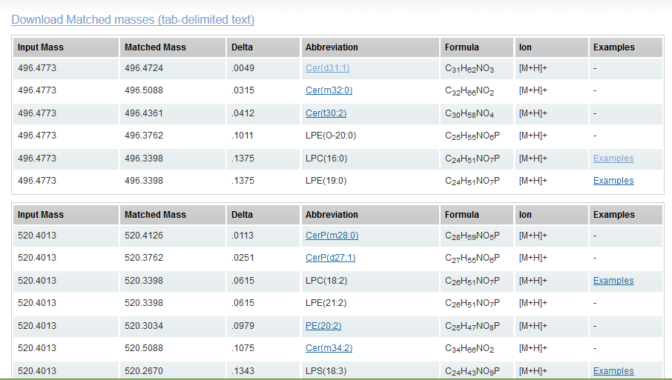
Results page for precursor ion search
Output: view in online format (below) or as tab-delimited text file
Output features: Sub-table for each input ion.
Links: On-demand expansion of all possible chain combinations (abbreviation)
Links: Matches of bulk species to discrete structures in LMSD database (examples)

Slide 46
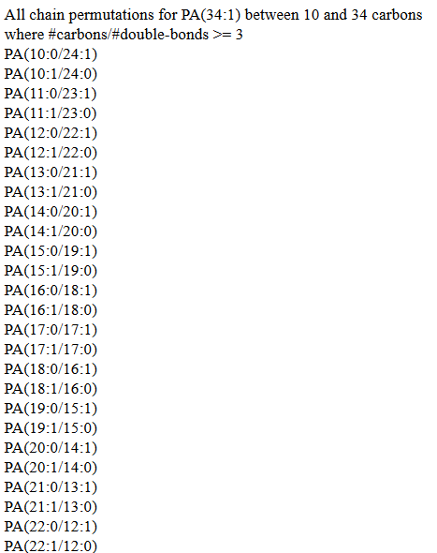
Expansion of species level to display all possible chain combinations within defined chain and chain/double-bond ratio limits

Slide 47
Links to examples of discrete structures in LMSD database with the identical bulk structure
*This feature was implemented by computing the “bulk” abbreviation (where possible) for every structure in the LMSD database

Slide 48
Computationally-generated database
of oxidized phospholipids
Resources →Tools → MS analysis→Glycerophospholipids
67 different oxidized chain species at sn2 position derived from C18,C20 and C22 precursors

Slide 49
Computationally-generated database
of oxidized phospholipids
Resources →Tools → MS analysis → Glycerophospholipids

Slide 50
Match MS/MS data vs Glycosylceramide in-silico database
Searches computationally generated database of 400 different headgroups, 45 different sphingoid bases and 52 different N-acyl chains
Resources →Tools → MS analysis→Sphingolipids

Slide 51
Predict Glycerophopholipid MS/MS product ions for a molecule of interest
Resources →Tools → MS analysis→Glycerophospholipids

Slide 52
Predict Glycerophospholipid MS/MS product ions for a molecule of interest

Slide 53
LipidFinder: A computational workflow for discovery of lipids
In high-resolution LC/MS datasets
Resources →Tools → MS analysis →Multiple classes
LipidFinder on LIPID MAPS: peak filtering, MS searching and statistical analysis for lipidomics
Eoin Fahy, Jorge Alvarez-Jarreta, Christopher J Brasher, An Nguyen, Jade I Hawksworth,
Patricia Rodrigues, Sven Meckelmann, Stuart M Allen, Valerie B O'Donnell
https://doi.org/10.1093/bioinformatics/bty679

Slide 54
LipidFinder: A computational workflow for discovery of lipids
In high-resolution LC/MS datasets
Test samples
Perform statistical analysis (Volcano plot, OP-PLSDA, Random-forest, ANOVA analysis) based on experimental groups (factors) to identify significantly up/down regulated features.
Run MS search on this (much smaller) selected peaklist to focus on the biologically significant features
UPLC/LCMS
XCMS
Peak Filtering
Statistical analysis of experimental groups
LIPIDFINDER
(Large peaklist)
MS searching
Lipid classification
Refined peaklist of
significantly altered features
(smaller peaklist)
Results

Slide 55
MS Standards library
Resources →Standards

Slide 56
Experimental data on LIPID MAPS
Resources →Experimental data

Slide 57
All studies on Metabolomics Workbench (65% are lipids)
~1000 experimental studies reporting ~180,000 metabolite species
~150,000 of these metabolite species were mapped to RefMet classification

Slide 58
RefMet Metabolite Classification and indexing
Lipids
Non-lipids
LIPID MAPS
Classification
ClassyFire
Classification
Uncurated classes
Indexing
Curation,
Indexing
RefMet database with indexed metabolite classification
Indexing of metabolite classes/subclasses facilitates logical ordering of data

Slide 59
Web Portal queries lipidomics data on Metabolomics Workbench
~600 studies in MW have reported named lipids (excluding polyketides)
>320 of those have >= 20 named lipids
Resources →Experimental data→Lipidomics Data on MW

Slide 60
Tools for Statistical analysis
Resources →Tools → Statistical analysis

Slide 61
Portable lipidomics analysis toolbox design
REST service
obtains RefMet
classification data
Portable analysis toolbox codebase
(R files, PHP, Javascript)
+ configuration file
Metabolomics Workbench
R statistics application
+
Libraries
User interfaces
Results

Slide 62
Resources →Tools → Statistical analysis

Slide 63
Tools for Statistical analysis: output

Slide 64
Tools for Statistical analysis: Map names to RefMet

Slide 65
Tools for Statistical analysis: Classified names

Slide 66
Tools for Statistical analysis: Classified names

Slide 67
Volcano plot: pairwise comparison of 2 experimental conditions

Slide 68
Bubble plot display of Volcano plot data
Comparing Diabetic and control mice
Color of circles represents fold change value red:group2/group1 >1 (upregulated)
green:group2/group1<1 (downregulated)
Size of colored circles represents
# of (significant) metabolites per class
with p-value and fold change
exceeding selected cutoff values
P-value on y axis
Size of gray circles represents
# of all reported
metabolites per class
Mouse over bubble to view
# of metabolites per class
Classes order by classification index on x axis

Slide 69
Crohn’s disease vs controls
Volcano plot/class enrichment
Publication: pathway enrichment

Slide 70
Crohn’s disease vs controls
Volcano plot/Bargraph by class
Publication: Bargraph by pathway

Slide 71
Under development at LIPID MAPS
Protocols section
Sample prep/MS analysis methods
By lipid category
Pathways section
Update and migration to
WikiPathways format

Slide 72
Acknowledgements
Cardiff University
Valerie O’Donnell (PI)
Caroline Jeffs
Jorge Alvarez-Jarreta
Maria Valdivia
Robert Andrews
Babraham Institute
Michael Wakelam(PI)
Simon Andrews
An Nguyen
University of California San Diego
Shankar Subramaniam (PI)
Edward Dennis (PI)
Dawn Cotter
Funded by Wellcome Trust

